Slide 1


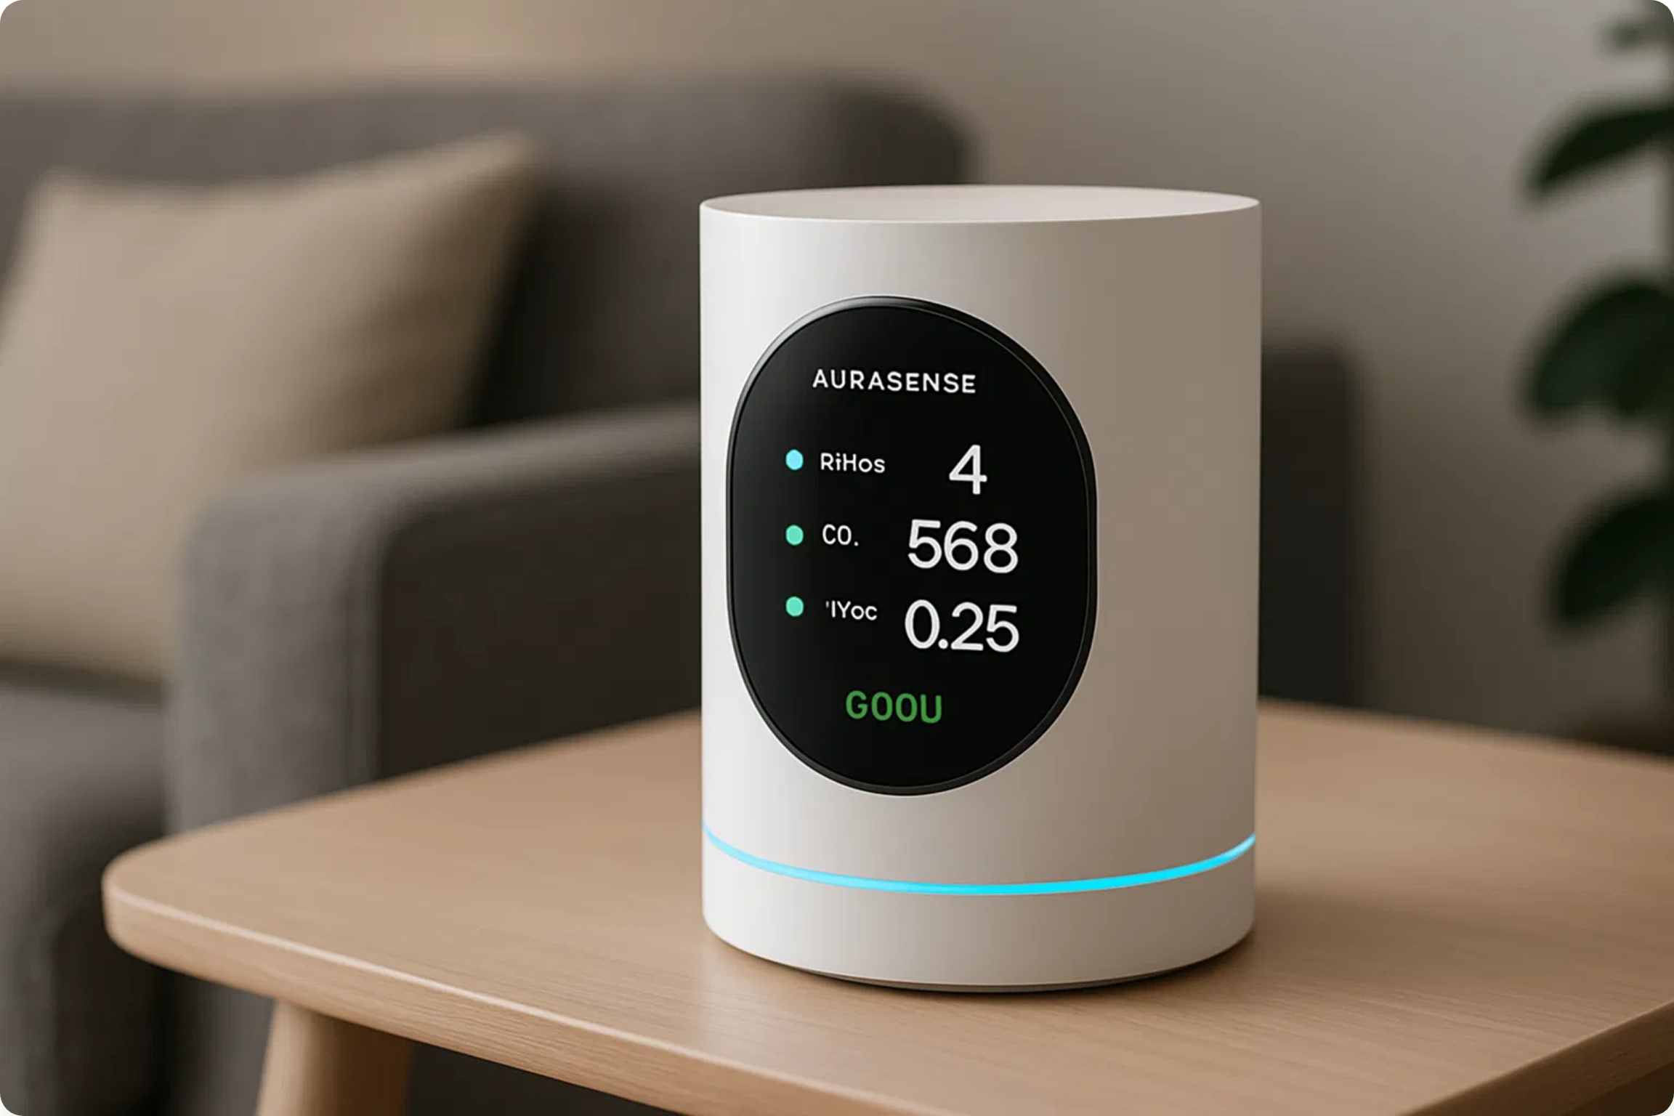
AuraSense AI
Revolutionizing Indoor Air Quality
June 2025

Slide 2


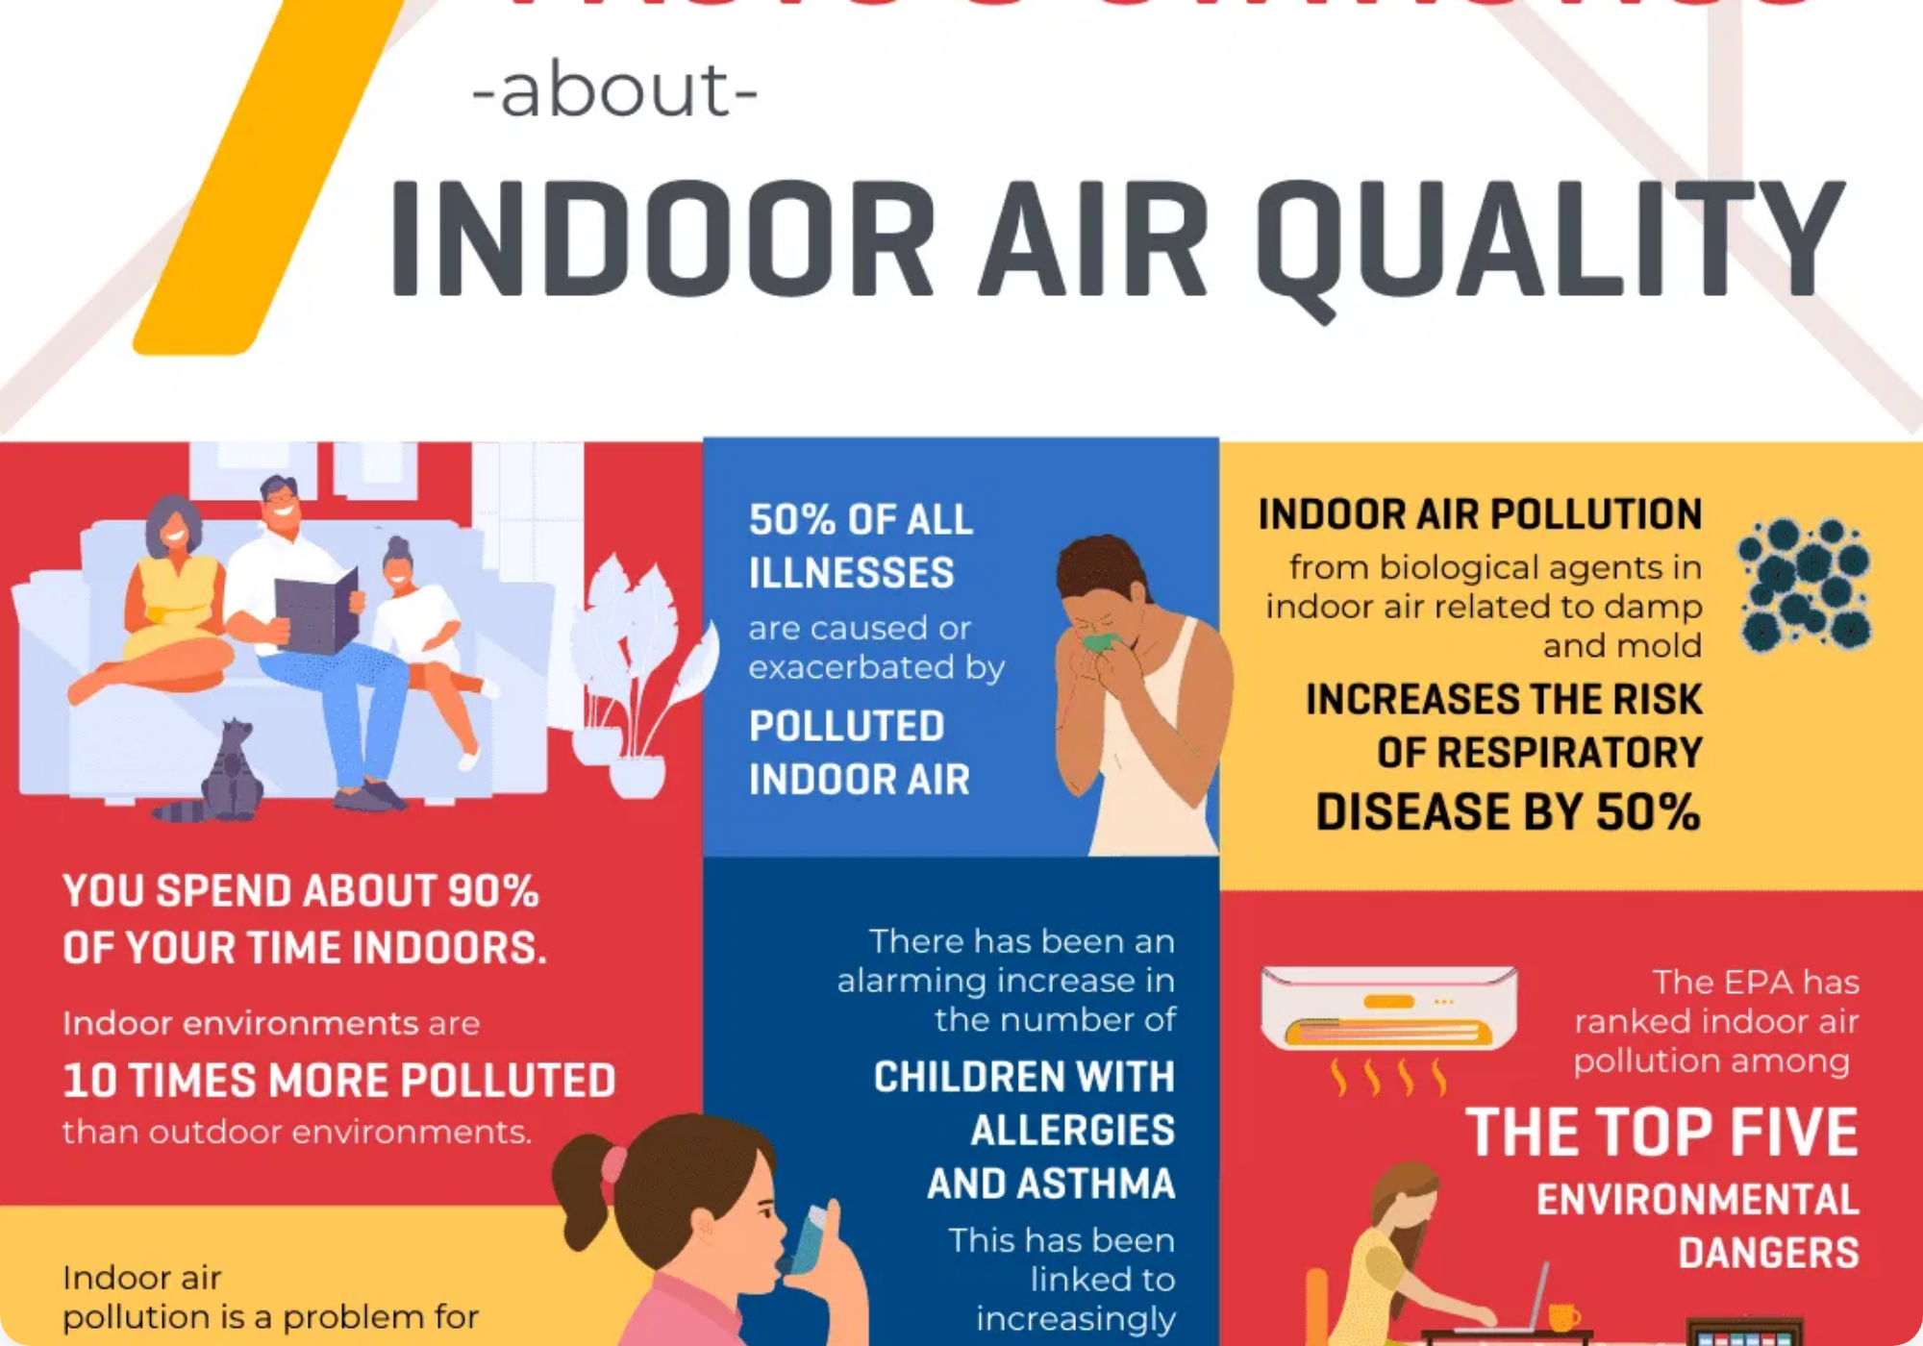
The Problem
Indoor Air Quality Crisis
Indoor air is often
2-5x more polluted
than outdoor air
We spend
90% of our time indoors
Poor air quality linked to respiratory issues, allergies, and decreased cognitive function
Existing solutions are reactive, not proactive
50%
$15B
68%
of all illnesses are related to indoor air quality
annual healthcare costs due to indoor air pollution
of consumers are concerned about their indoor air quality

Slide 3

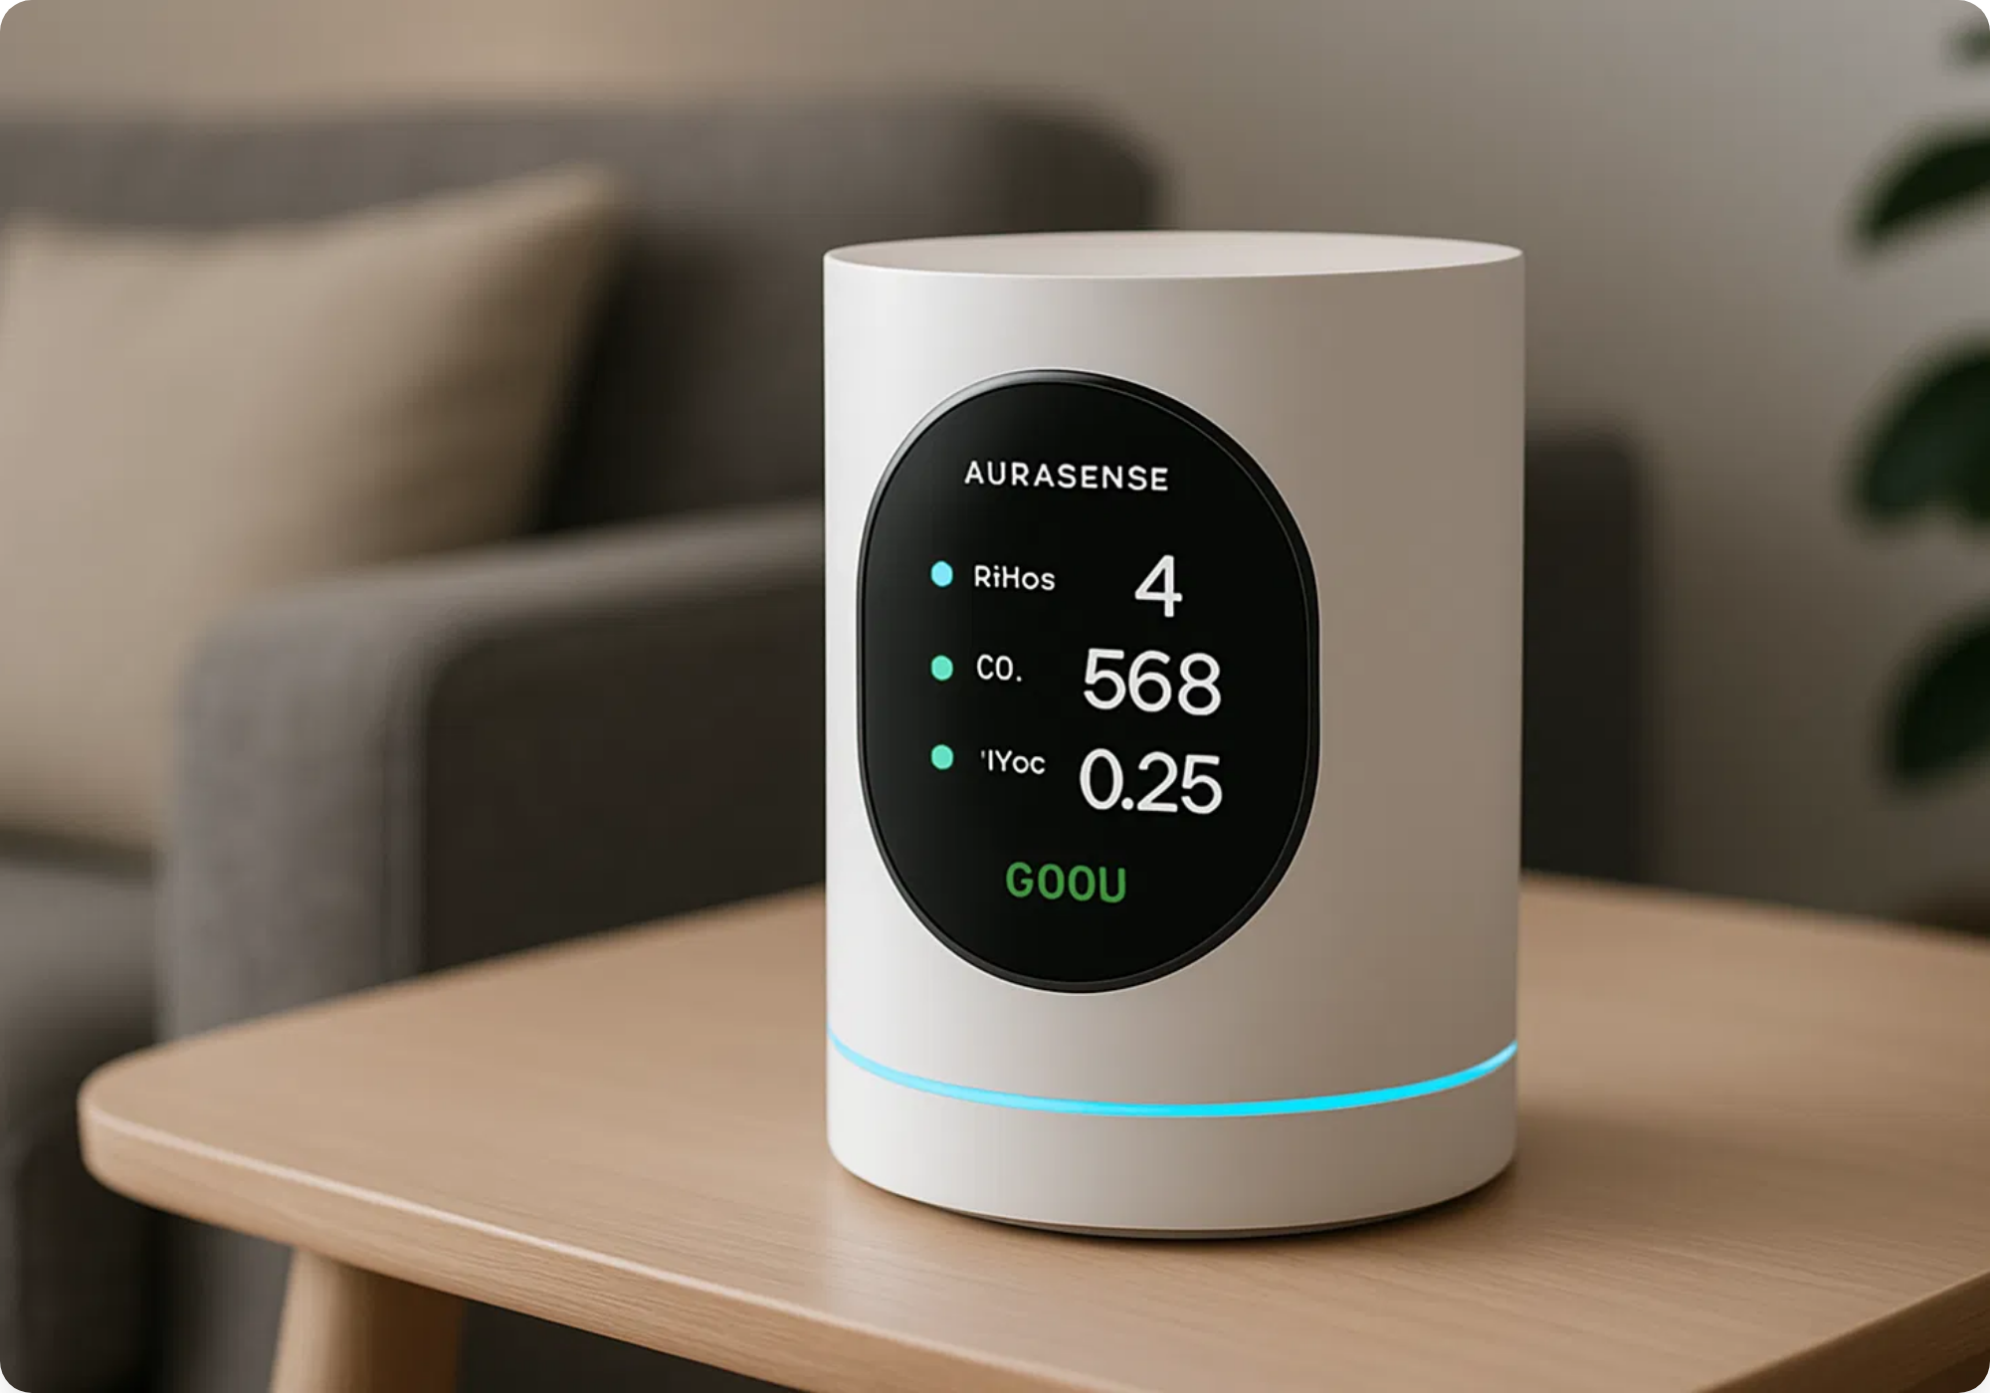



Our Solution
Introducing AuraSense
A smart home device that uses AI to monitor indoor air quality, identify potential allergens and pollutants, and provide personalized recommendations for improving air health.
AuraSense transforms how we understand and improve our indoor air quality with proactive, personalized insights.
Real-time Monitoring
AI-Powered Analysis
Smart Integration
Continuous tracking of PM2.5, VOCs, CO2, humidity, and temperature
Identifies specific allergens and pollutants with advanced machine learning
Seamlessly connects with existing smart home systems for automated responses

Slide 4

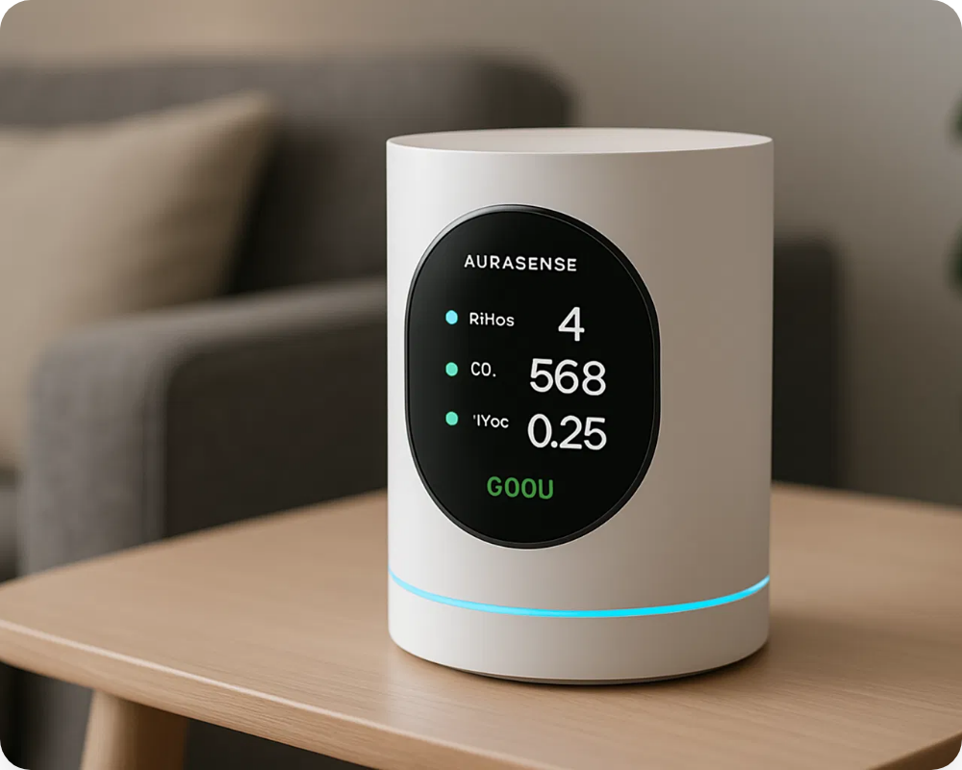

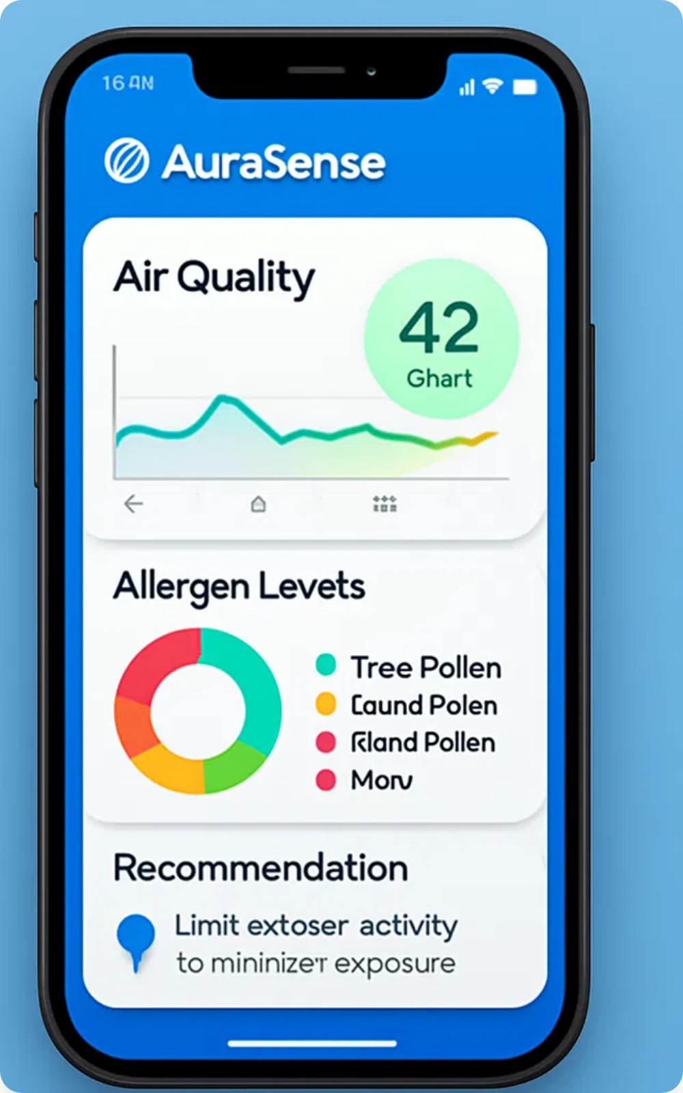
















Product Overview
AuraSense Device
Mobile Application
Advanced sensor array
Real-time dashboard
Wi-Fi & Bluetooth connectivity
Historical data analysis
24-hour backup battery
Customizable alerts
Voice alerts for critical issues
Personalized recommendations
Military-grade encryption
Smart home integration
Family sharing
Sensing Capabilities
PM2.5 & PM10
VOCs
CO2 Levels
Temperature
Humidity
Pollen Detection
AI-Powered Features
Our proprietary algorithms learn your home's air quality patterns and provide increasingly personalized insights and recommendations over time.

Slide 5

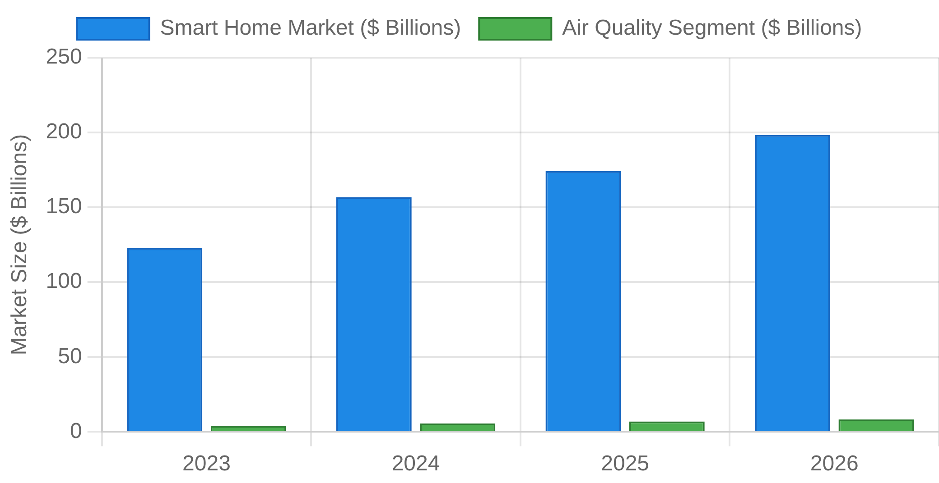


Market Opportunity
Smart Home Market Growth
Target Segments
Residential
Commercial
Health-conscious families
Office buildings
Allergy & asthma sufferers
Schools & daycares
Smart home enthusiasts
Healthcare facilities
Urban apartment dwellers
Hospitality industry
Source: Statista, Fortune Business Insights, 2025
$205B
22.3%
$8.5B
Global smart home market size by 2026
CAGR for smart home market (2023-2026)
Indoor air quality monitoring segment by 2026

Slide 6











Competitive Advantage
Competitive Landscape
Our Advantages
Features
AuraSense
Competitor A
Competitor B
Competitor C
Proprietary AI Technology
Our advanced algorithms provide unmatched accuracy in identifying specific allergens and pollutants.
Real-time Monitoring
AI-Powered Analysis
Comprehensive Integration
Allergen Identification
Works with all major smart home platforms for seamless automation and control.
Personalized Recommendations
Health-First Approach
Smart Home Integration
Developed with input from environmental health experts to prioritize meaningful health outcomes.
Automated Response
Privacy-Focused Design
All sensitive data is processed locally with military-grade encryption for cloud backups.

Slide 7

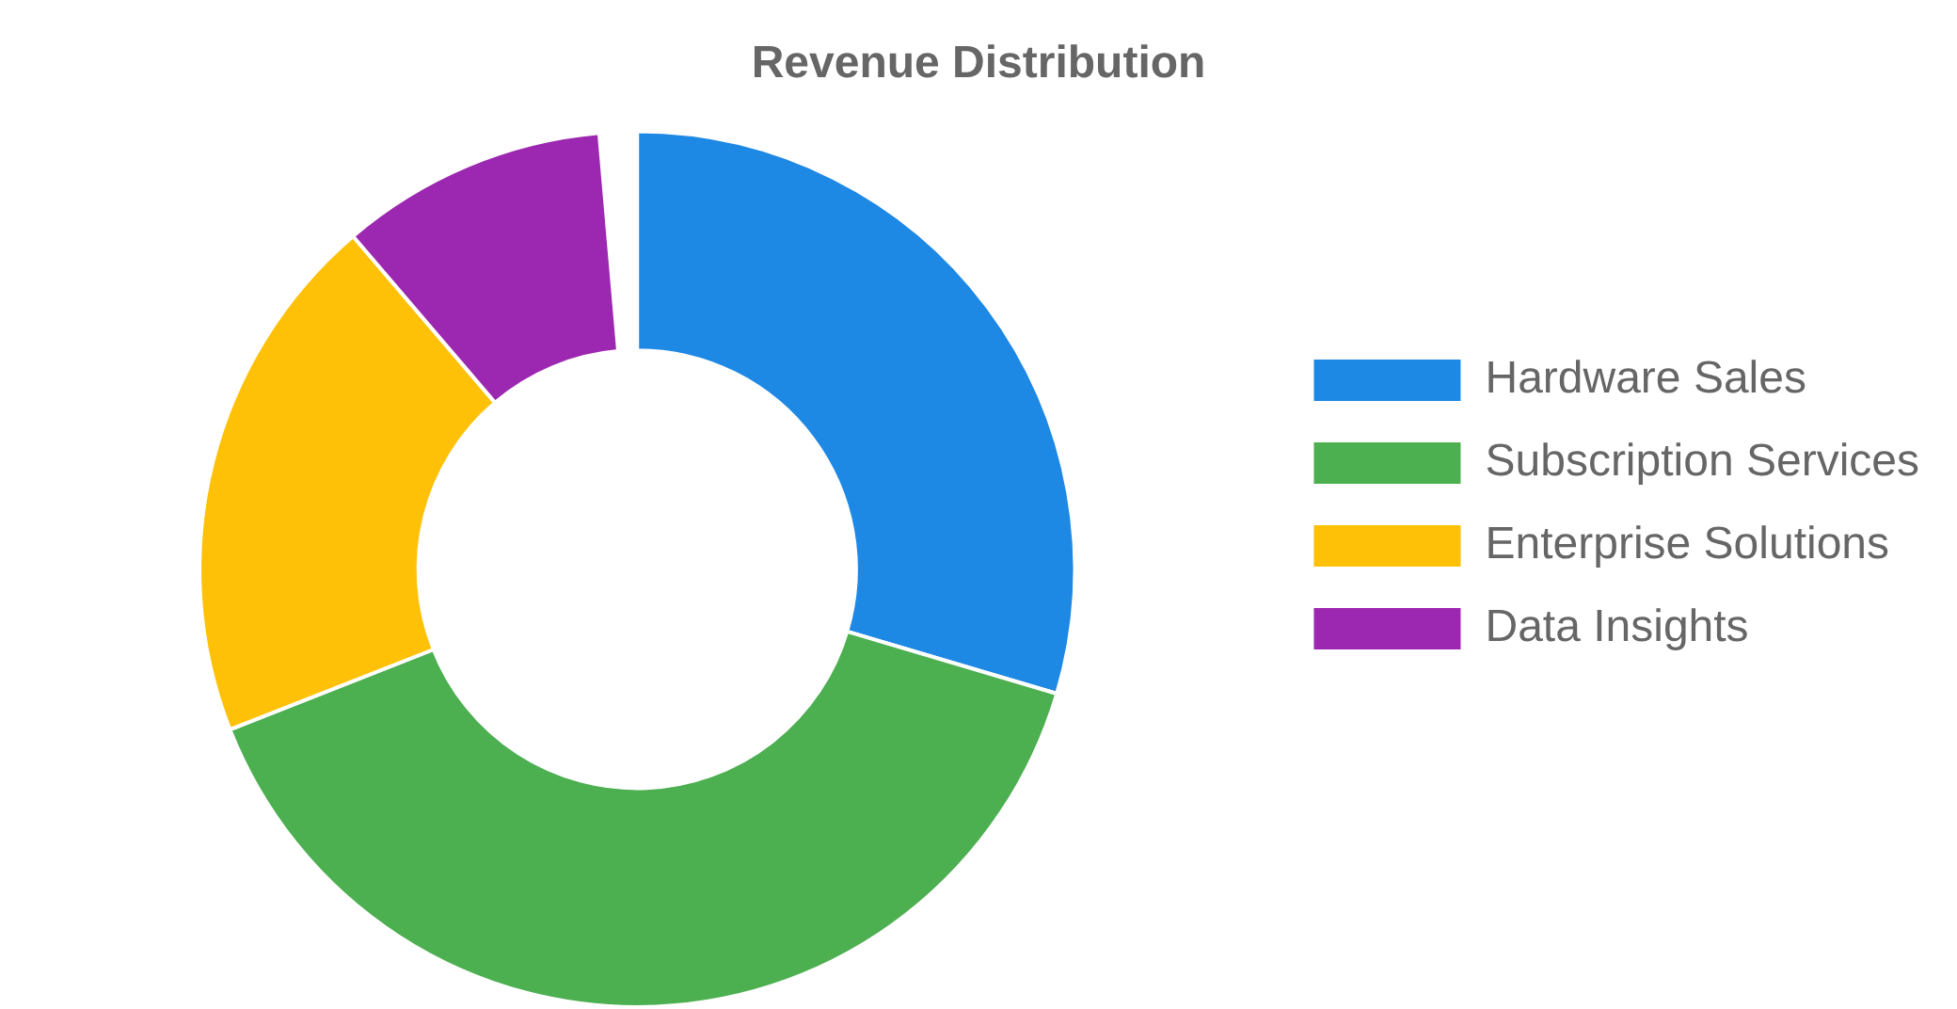







Business Model
Revenue Streams
Pricing Strategy
Basic
MOST POPULAR
Family
$149
Premium
$499
$199
+ $4.99/mo
+ $14.99/mo
Device + Basic App
+ $9.99/mo
3 Devices + Full App
Device + Full App
Real-time Monitoring
Advanced AI Analysis
All Premium Features
Basic Alerts
Personalized Insights
Multi-room Support
Advanced AI Analysis
Smart Home Integration
Family Health Profiles
Smart Home Integration
Multi-room Support
Priority Support
Recurring Revenue
Growth Projection
70% of revenue from subscriptions ensures stable cash flow and customer retention.
Projected to reach profitability by Q3 2026 with 35% YoY growth.
Enterprise Solutions
Custom pricing for commercial buildings, healthcare facilities, and educational institutions.

Slide 8











Our Team
Sarah Chen, Ph.D.
Michael Rodriguez
Aisha Johnson
CEO & Co-Founder
CTO & Co-Founder
COO
Former Lead Researcher at MIT Environmental Solutions Lab with 15+ years in air quality monitoring systems.
Former AI Research Lead at Google with expertise in machine learning and IoT integration. Stanford CS graduate.
Former VP of Operations at Nest with extensive experience scaling hardware startups and supply chain management.
David Park
Elena Petrov
Head of Product
Head of Engineering
Former Product Manager at Apple HomeKit with expertise in user-centered design and smart home ecosystems.
IoT hardware specialist with 10+ patents in sensor technology. Previously led engineering at Bosch Smart Home.
Advisory Board
Dr. Robert Kim
Lisa Gonzalez
Prof. James Wilson
Environmental Health, Harvard
Former CIO, Honeywell Home
AI Ethics, Stanford

Slide 9





Roadmap
Q1 2025
Q3 2025
Q1 2026
Q3 2026
2027
Prototype Development
Beta Testing & Production
Sensor array integration completed
Beta testing with 100 households
Initial AI algorithms developed
Manufacturing partnerships established
First prototype tested in lab conditions
App development finalized
Secured seed funding of $1.5M
Series A funding round ($5M target)
Market Launch
Expansion
Full product launch in North America
European and Asian market entry
Retail partnerships with major chains
Enterprise solution development
Marketing campaign rollout
Additional product line expansion
Customer support infrastructure
Series B funding round
Key Upcoming Milestone
Full product launch scheduled for Q1 2026 with initial production run of 10,000 units.

Slide 10








Join Us in Revolutionizing
Indoor Air Quality
We're seeking strategic partners and investors who share our vision of creating healthier indoor environments through innovative technology.
Investment Opportunity
Strategic Partnerships
Raising
$5 million Series A
Smart home ecosystem integration
Valuation:
$25 million
Retail distribution channels
Use of funds: Production, marketing, team expansion
Healthcare provider collaborations
Projected ROI:
5x in 3 years
Research & development partnerships
Contact Us
invest@aurasense.ai
San Francisco, CA
+1 (415) 555-0123
www.aurasense.ai
"Breathe better. Live better."

